Slide 1

Marriage Equality Webinar: Courting Success
NOW Webinar
September 23, 2014
  www.now.org
Notes:
Welcome to the Marriage Equality Workshop.
During the next hour we’ll provide an overview of the current status of marriage equality, where we’re headed, and how you can help take action so that everyone will have the freedom to marry.

Slide 2
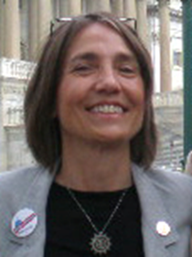


Presenters
Bonnie Grabenhofer
NOW VP Action
vpaction@now.org
Maya Rupert
Policy Director
National Center for
Lesbian Rights
mrupert@nclrights.org
Kristina Romines
NOW Field Organizer
field@now.org
Notes:
My name is Bonnie Grabenhofer.
I am the Action Vice President for the National Organization for Women.
And I am delighted to be here with all of the activists on this webinar and this great panel.
With me are Maya Rupert, Policy Director for the National Center for Lesbian Rights, and Kristina Romines, the Field Organizer at NOW.

Slide 3
Topics
Current status of marriage equality
Marriage equality in the courts
National Action Campaign: 2004-2013
  Education
  State Legislation
  Ballot Initiatives
National Action Campaign: 2013-2015
  Courting Success
Messaging
Federal legislation and policy
Notes:
In this workshop I’ll start with an overview of the current status of marriage equality including how we got there and where we’re headed.
Maya Rupert will talk the recent court cases and what’s coming up.
We’ll talk about how the strategies of NOW’s Marriage Equality National Action Campaign have evolved, the current focus, and how you can help no matter which state you live in.
We’ll also talk about the messaging that proved successful in the 2012 ballot initiatives and helps encourage support for marriage equality -- which is very important to moving us forward.
And we’ll talk about the federal legislation and policy initiatives being introduced to ensure that more same-sex couples have access to the same federal benefits granted to opposite-sex married couples.

Slide 4
States with Marriage Equality
2004: Massachusetts
2008: Connecticut
2009: Iowa, Vermont, New Hampshire, Washington D.C.
2011: New York
2012: Washington, Maryland, Maine
2013: California, Delaware, Hawaii, Illinois, Rhode Island, Minnesota, New Jersey, New Mexico
2014: Oregon, Pennsylvania
Notes:
We now have marriage equality in 19 states plus the District of Columbia.
It began with Massachusetts in 2004 until going gangbusters in the last several years.
And NOW activists have been there every step of the way, contributing to most of these victories. In many cases working their hearts out for years and their fingers to the bone to finally achieve marriage equality in their states.
We started our first national action campaign for Marriage Equality in 2004 and have had several more resolutions in support including the resolution last year reenergizing the Marriage Equality National Action Campaign.
How many of you have worked toward marriage equality? Raise your hand.
Thank you for all the work you have done and will do as we work to achieve marriage equality in the remaining 31 states.

Slide 5
How did these States Gain Marriage Equality?
9 through state/DC legislatures:
  Delaware, Hawaii, Illinois, Minnesota, New Hampshire, New York, Rhode Island, Vermont, Washington DC
3 through popular vote/ballot initiative:
  2012: Maine, Maryland, Washington
8 through the courts:
  Connecticut, Iowa, Massachusetts,
  2013: California, New Jersey, New Mexico,
  2014: Oregon, Pennsylvania
Notes:
Let’s look at how we got there.
So far, most of the victories have been through the state legislatures.
Just 3 have been thru ballot initiatives – all in 2012. Until 2012, our side lost every single ballot initiative – most of them bans on same-sex marriage.
And 8 have been thru the courts – More than half of them are very recent – in just the past year or so.
California was a result of the Prop 8 decision in June 2013.
And New Jersey, New Mexico, Oregon, and Pennsylvania, all followed the Windsor decision in June 2013 which removed the prohibition of federal recognition of marriages of same-sex couples in states where it is legal.

Slide 6
Marriage Equality in the Courts
  79 lawsuits in 31states & Puerto Rico
Since June 2013 Windsor Decision:
39 victories ( and just 2 losses)
  13 in state court
  22 in federal court
  4 in appellate court
    Decisions
  4 = Freedom to Marry
  Most ruled bans unconstitutional (many appealed or stayed)
  6 stayed that would have granted Freedom to Marry
  Several recognize out-of-state marriages
Notes:
There are now 79 lawsuits in all 31 remaining states and Puerto Rico in which the state bans on same-sex marriage are being challenged as unconstitutional.
Since the Windsor decision last June overturning a key part of Defense of Marriage Act (DOMA) defining marriage as between a man and a woman, we have had 39 victories for the freedom to marry and only 2 losses!
13 were in state court
22 in federal court
Many rulings are being appealed and many decisions have been stayed.
4 cases have been heard in appellate court.
Four decisions have resulted in the freedom to marry in additional states.
6 decisions that would have granted the freedom to marry, have been stayed.
Several of the rulings have resulted in a state recognizing out-of-state marriages, like Kentucky and Ohio.
Transition: And now Maya will talk more about the federal circuit court cases.

Slide 7
Federal Circuit Court Cases
Recent wins
Arguments
  Discrimination based on sexual orientation
  Sex discrimination
Upcoming cases
Going to the Supreme Court
Notes:
Maya

Slide 8
Which Case?
One or more of the following cases could be heard beginning September 29, 2014 at the U.S. Supreme Court’s annual conference:
Utah (Herbert v. Kitchen): 10th Circuit
    Affirmed June 26, 2014
Oklahoma (Smith v. Bishop): 10th Circuit
    Affirmed July 26, 2014
Virginia (Schaefer v. Bostic): 4th Circuit
    Affirmed July 28, 2014
Wisconsin (Walker v. Wolf): 7th Circuit
    Affirmed September 4, 2014
Indiana (Bogan v. Baskin)” 7th Circuit
    Affirmed September 4, 2014

Slide 9
Commonalities of the Victories
  Legal and Social Consistency
  These cases have underscored the concept that denying same-sex marriage to LGBT couples is an indefensible position under the United States and now, under many state constitutions.
    “If no social benefit is conferred by a tradition and it is written into law and it discriminates against a number of people and does them harm beyond just offending them, it is not just a harmless anachronism; it is a violation of the equal protection clause.”
                Judge Posner from the 7th Circuit Court of Appeals opinion concerning the state marriage bans in Wisconsin and Indiana.
Notes:
Judge Posner on the 7th Circuit Court of Appeals delivered a very scathing opinion that eviscerated the state same-sex marriage bans in Wisconsin and Indiana.

Slide 10
Louisiana: A Loss and a Victory
Robicheaux v. George
On September 3, 2014, U.S. District Judge Martin Feldman became the first federal judge since June 2013 to uphold marriage discrimination and respect for same-sex marriages performed in other states. Appeal to the 5th Circuit Court of Appeals is pending.
In Re Costanza and Brewer
On September 22, 2014, Judge Edward Rubin of the 15th Judicial District Court ruled in favor of the freedom to marry and declared Louisiana’s marriage ban unconstitutional.
Notes:
Note: Justice Ginsburg’s address to the University of Minnesota Law School (see slide 13) was delivered before this district court split in Louisiana. Thus, the urgency of the U.S. Supreme Court to make a definitive ruling on same-sex marriage in the event of a federal circuit appellate split – here in the 5th Circuit if its decides to uphold Louisiana’s ban on same-sex marriage - may be closer in time than she initially predicted.
[Justice Ginsburg’s reference in her speech on the following slide is to 6th Circuit review of the district courts in Kentucky, Michigan, Ohio, and Tennessee; see slide 13].

Slide 11
Fundamental Question for the U.S. Supreme Court
“Supreme Court justices typically take up issues only when lower courts disagree. But in this case, even victors in the lower courts may want the high court to address the question — to settle the issue once and for all nationwide.”
  Public opinion and the shift in American culture concerning same-sex marriage and identity appears to be playing a strong role in this socio-legal debate.
Notes:
Source: Michael Conroy, Court Rules against Gay Marriage Bans in 2 states, The Washington Post (Sept. 4, 2014), available at http://www.washingtonpost.com/national/court-rules-against-gay-marriage-bans-in-2-states/2014/09/04/c7835682-3467-11e4-9f4d-24103cb8b742_story.html (last visited Sept. 23, 2014).

Slide 12
Justice Ginsburg on Same-Sex Marriage Cases
In an address to the University of Minnesota Law School, Justice Ginsburg highlighted the powerful “shift in public perception of same-sex marriage that she attributes to gays and lesbians being more open about their relationships.”
She predicts that there will be some urgency for the U.S. Supreme Court to settle the question on same-sex marriage if the 6th Circuit upholds state bans on same-sex for the pending cases on appeal in Kentucky, Michigan, Ohio, and Tennessee.
Notes:
‘Having people close to us who say who they are — that made the attitude change in this country,’ Ginsburg said.
Source: Brian Baskt, Ruth Bader Ginsburg: Watch 6th Circuit For SCOTUS' Next Move On Gay Marriage, Huffington Post Politics (Sept. 17, 2014), available at http://www.huffingtonpost.com/2014/09/16/ruth-bader-ginsburg-gay-marriage_n_5833090.html (last visited Sept. 23, 2014).

Slide 13
NOW Marriage Equality
National Action Campaign Evolved
2004 +
  Began with focus on education
  Legislative campaigns & ballot initiatives
2011-2013: Legislation & ballot initiatives
  Active campaigns
  Other states: build public support
  All: Respect for Marriage Act
2013-2015: Courting Success
  Visibility
  Build public support
Notes:
For over four decades NOW has been an outspoken leader in the fight for LGBTQIA rights. NOW first committed to fighting for lesbian rights in 1971.
In 1995 NOW declared that marriage was a fundamental right that must not be denied to same-sex couples.
In 2004 the NOW PAC felt so strongly about the importance of marriage equality that support for it became a NOW PAC endorsement criterion. And in that same year we passed a resolution elevating our work on marriage equality to a National Action Campaign.
This first national action campaign began with a focus on education – education of ourselves; candidates & elected officials; and the public.
Several years later, we became involved in state legislative campaigns and ballot initiatives.
In 2011 we passed a resolution focusing on working on marriage equality legislation and ballot initiatives in states where there were active campaigns.
NOW activists worked very hard fighting against the legislative and ballot initiative bans as well as contributing to the victories in the last several years. States without active campaigns continued to work on education and building public support.
And all states were asked to work on getting sponsors for the Respect for Marriage Act which would overturn the Defense of Marriage Act or DOMA.
Although the Windsor decision in June 2013 overturned Section 3 of DOMA that prohibited federal recognition of valid marriages of lesbians and gay men, we still need to repeal the bad language in Section 2, Powers to the states which allows states to refuse to recognize the valid marriages of same-sex couples performed in other states. So all states need to get their US Representatives and Senators to cosponsor or at least agree to vote for the Respect for Marriage Act.
Since the Windsor decision in June of 2013, the fight has shifted to the courts. And NOW’s Marriage Equality National Action Campaign is now focused on visibly demonstrating support for marriage equality and building public support in those states without marriage equality – all 31 of which have court cases.
Let’s look a little more closely at what’s changed.

Slide 14
2011-2013:Legislation & Ballot Initiatives
State Legislation – get legislative sponsors, votes
    Lobby legislators – visits, calls, email, twitter
    Get others to contact legislators - Phone banks, email
  Ballot Initiatives - voters
    Petitions/checking petitions
    Phone banks
    Canvassing
    Public education
    Get Out the Vote
  Both-Show/build support
    Demonstrations/Rallies
    Visibility – buttons, signs, tabling
    Social media/email
    Letters to the editor
Notes:
In the state legislative campaigns, the focus was on lobbying legislators – getting them to sponsor and vote for marriage equality legislation.
For ballot initiative campaigns, the focus was on the voters – getting them to support or oppose the initiative and getting out the vote.

Slide 15

2013-2015: Building Public Support
…Courting Success
Court Case
  Sign on to amicus brief
Show visible support
  Demonstrations/rallies
  Pride events
Increase favorable public opinion
  Workshops, panels, forums
  Tabling
  Letters to the editor
  Social media
  Conversations with family, friends, neighbors
  Phone calls
Notes:
Bonnie
Grassroots activists generally have been most active with legislation and ballot initiatives. But currently the focus is on the courts rather than legislation or ballot initiatives. There are about 79 active lawsuits in 31 states and Puerto Rico. So, how can we help?
NOW doesn’t have a legal team that handles these cases – like our friends at the National Center for Lesbian Rights and other organizations -- but as grassroots activists we can play an important role.
Some say activists can’t do much to influence how a court case will be decided.
It’s true that you can’t lobby a justice, but we hear that judges don’t like to rule too far ahead of public opinion. You can help create a climate for a favorable ruling by increasing the amount of public support for marriage equality. How can we do that?
Transition: Kristina Romines, NOW’s Field Organizer, will talk about what you can do.
Kristina
State NOW chapters can sign on to amicus briefs -- like New Mexico NOW did last year. And the court ruled in their favor.
If you are part of another LGBTQIA or civil rights group, your group may also be able to sign on to an amicus brief.
We can also demonstrate our support for marriage equality and show that the majority of the public favor marriage equality. And while they won’t admit it, we believe the judges will have to take notice.
Show visible support
You can also do demonstrations and rallies, like those done when the DOMA and Prop 8 cases were heard and more recently when the circuit court cases were heard such as in the 6th Circuit Court of Appeals in Cincinnati and in the 7th Circuit Court of Appeals in Chicago.
Another way to show support is to organize and participate in Gay Pride events.
We need to increase favorable public opinion – change hearts and minds. Get those who oppose marriage equality to support it. It’s the ground work that creates the climate for a favorable ruling.
We can do that with:
Workshops, panels, forums
Tabling
Letters to the editor
Social media
Conversations with family, friends, neighbors
Phone calls
A good way to increase favorable public opinion is through workshops.
NOW is partnering with Marriage Equality USA’s National Equality Action Team to train and support NOW activists who will serve as facilitators for the Workshop: The Heart of What Matters.
The program is designed to persuade the moveable middle in states without marriage equality. This program will be implemented by activists who will facilitate the trainings in their communities. For example, three members of Georgia NOW are in the process of becoming facilitators and had signed up 27 people to their training on September 20.
Bonnie
Change, and especially attitudes, don’t happen overnight. It takes time and a lot of work. I’m from Illinois and marriage equality passed just recently in 2013. But Illinois NOW made it a priority in 2004 when NOW started its national action campaign, and we have been doing workshops, demonstrations, rallies, and Pride parades; and including it as a required criterion in our candidate discussions and endorsements since then. Although marriage equality just recently passed in Illinois, it was a LONG time coming. We had been building public support, and educating and electing supportive legislators for nearly 10 years before it had enough votes to pass.
So keep working at it. Public support has been increasing at an amazing rate because of the work that activists like you have been doing.
With all of us working together, we can gain the freedom to marry for everyone in every state.
Before we leave this topic, let’s take a few minutes to talk about messaging.

Slide 16
Messaging – Why?
Why do same-sex couples want to get married?
  A) For rights and benefits?
  B) To acknowledge love and commitment?
Notes:
In a poll by Third Way, when asked why couples like you might want to get married, 58% said, “to publicly acknowledge their love and commitment to each other.”
But when asked why gay couples might want to get married, “acknowledging love and commitment” lost 20 points with about half saying “for rights and benefits.”
There is a direct correlation between how people answered this question and whether they were supportive of marriage equality.

Slide 17
Messaging – Love & Commitment
  60% who said “Rights and benefits” were
  uncomfortable with marriage equality
  60% who said “Love and commitment” were comfortable with marriage equality
Notes:
60% of the people who said “Rights and benefits” were uncomfortable with marriage equality.
60% of the people who said “Love and commitment” were comfortable with marriage equality.
When we first started talking about marriage equality, we talked about the unfairness of denying the 1,138 rights of marriage to same-sex couples.
If you worked on some of the earlier ballot initiatives, you’ll remember that it was one of the reasons discussed for voting against those dreadful bans. And we lost every one.
The messaging was modified in 2012 to emphasize Love and Commitment – and we won all 4! The messaging may not have been the only reason, but it may have been an important factor.
We’ve learned that to help people move toward supporting marriage equality, it is helpful to talk about how the reason opposite-sex couples and same-sex couples want to get married is the same: to publicly acknowledge their love and commitment for each other.
When talking to people about marriage equality, it is helpful if you can share a story – about your own relationship; about friends and what marriage means to them; or about your own evolution regarding support for the freedom to marry.
Transition: Although the Windsor decision in June 2013 overturned Section 3 of the Defense of Marriage Act that prohibited federal recognition of valid marriages of lesbians and gay men, we are still struggling to ensure that all same-sex married couples can have access to federal benefits of marriage.
Maya Rupert will talk a little more about the federal legislation and policy being pursued to make this happen.

Slide 18
Federal Legislation & Policy
DOMA
  On June 26, 2013, the U.S. Supreme Court struck down the portion of the Defense of Marriage Act (DOMA) that prohibits the federal government from recognizing same-sex marriages in the landmark decision U.S. v. Windsor
  This was a huge victory, but it’s important to remember a few additional points:
    This only struck down a portion of the Defense of Marriage Act and does not impact how states recognize marriages legally performed in other states.
    The federal government recognizing marriages that state governments don’t recognize creates an entirely new set of issues for same-sex couples and families.
    Many rights and benefits are conferred based on the state where a couple lives, not where they were married.

Slide 19
Federal Legislation & Policy
State of Celebration versus State of Residency
  For many federal laws that depend on marital status, the relevant consideration is where a marriage took place (state of celebration) as opposed to where the couple lives (state of residency)
  For example, immigration law allows a U.S. citizen to sponsor a same-sex foreign partner for citizenship as long as they were married in a state where it was legal.
  However, social security benefits are conferred to a surviving spouse based on whether their marriage is legally recognized in their state of residence. So if a couple is married in D.C., and then retires in Florida, and one of them passes away, the surviving spouse will NOT be treated as a spouse for social security benefits.
  VA benefits for veterans and their spouses are likewise based on place of residence.

Slide 20
Federal Legislation & Policy
Policy and Legislative Solutions
  Many federal policies and regulations that are dependent upon marital status can be amended by agencies without an act of Congress.
  For example, the Family and Medical Leave Act (FMLA) entitles eligible employees of covered employers to take unpaid, job-protected leave for specified family and medical reasons. The FMLA also includes certain military family leave provisions.
  The Department of Labor has published a Notice of Proposed Rulemaking (NPRM) to revise the definition of spouse under the FMLA in light of the Windsor decision.

Slide 21
Federal Legislation & Policy
Respect for Marriage Act
  Unfortunately, some issues like Social Security and Veteran’s Benefits are legislatively required to consider state of residence to confer benefits. Thus, a legislative solution is required.
  The Respect for Marriage Act would attempt to address some of these issues by completely repealing DOMA
    It would require all federal laws where marital status is implicated to consider state of celebration as opposed to state of residence.
    However, it would NOT require all states to recognize the validly entered into marriages of other states.

Slide 22
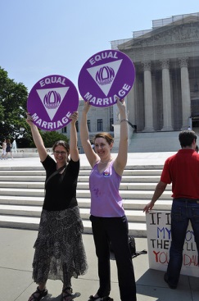
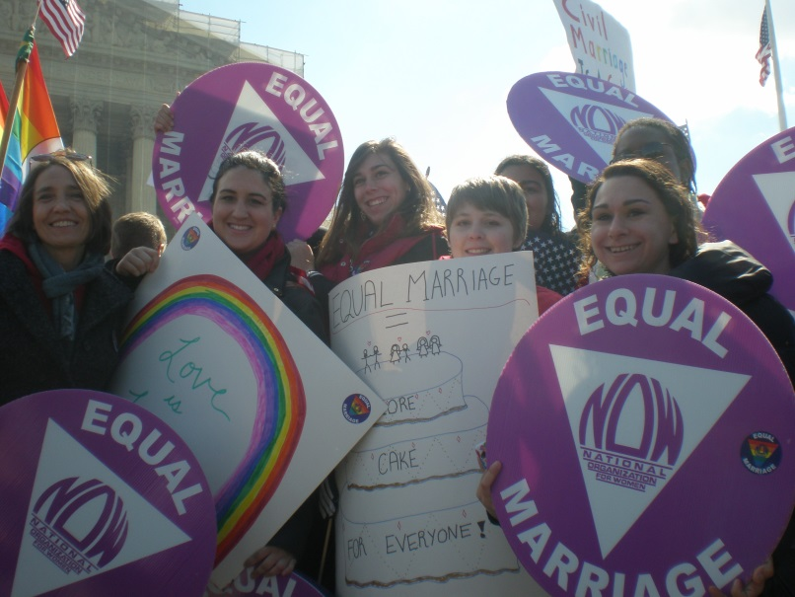
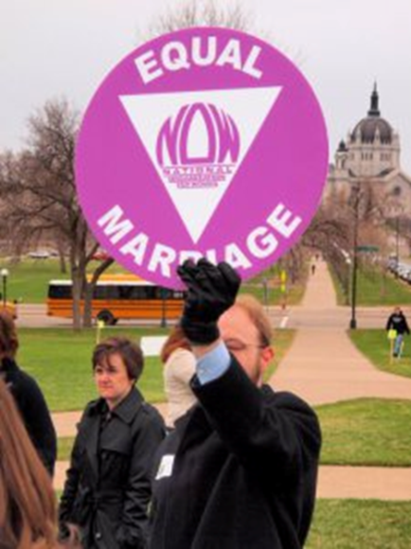
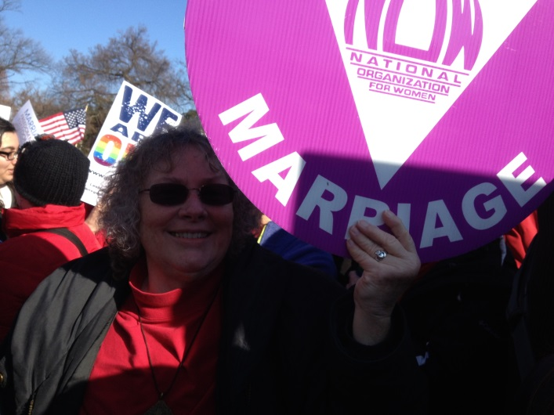

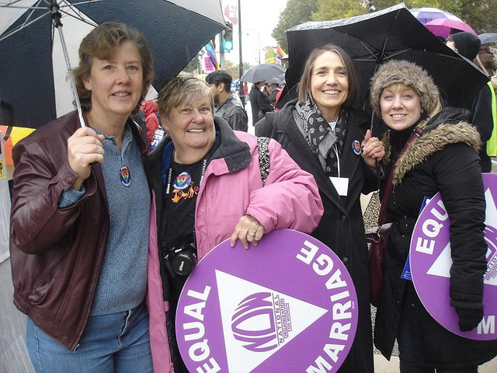
Questions?
field@now.org
vpaction@now.org
Notes:
Thank you, Maya, for sharing all this great information. These are federal policies we can all help support no matter where we live.
Are there any questions?
Conclusion
Thanks again to Maya Rupert from the National Center for Lesbian Rights and to Kristina Romines the Field Organizer at NOW who set up this webinar and to Paul Wommack who helped make sure it ran smoothly.
It will be posted on the NOW Leader Page for future reference.
And thanks to everyone for participating.

